Slide 1
Undercover Unix
Unit: Terminal, Day 3
Cybersecurity Boot Camp |

Slide 2
Today’s Goals
By the end of class, you will be able to:
Create and execute shell scripts using Unix commands.
Employ research and documentation to identify new commands for unfamiliar situations.
Use sed to make substitutions to a file.
Use awk to make changes to a file.
Notes:
Review goals; address any questions.

Slide 3
Let’s start with a warm-up.

Slide 4
Activity: Warm-Up Activity (10 min)
You've just been given a zip file that includes a Docs folder with folders and files from a user’s personal machine.
Use the command line to complete the following tasks:
Create two subfolders within the Music folder: one called FLAC and the other called MP3.
Write a command that finds all .mp3 and .flac files and copies them into their respective subfolders.
Write a command to count the number of .mp3 and .flac files in each folder.

Slide 5
Warm-Up Activity
Instructor Review
Notes:
Review goals; address any questions.

Slide 6
Let’s Get Scripting!

Slide 7
Shell Scripts
Prewriting scripts that can then be executed by a single script:
Instructor Demo
Notes:
Review goals; address any questions.

Slide 8
Activity: My First Shell Script (7 mins)
Instructions:
Create a shell script which accomplishes the following:
Creates a folder called Summary.
Combines all files in the Files folder into a single file called MySummary.txt.
Moves the MySummary.txt file into the Summary folder.
Previews the first ten lines of contents.
Run the shell script.
Hints:
To start you will first need to create a file. Use the terminal and type touch script.sh.
Consider testing the individual commands of your shell script in the command line. And then copy and paste into the shell script.

Slide 9
Learning New Commands and Echo
Instructor Demo
“tar manual unix”
“How to tar on the command line”
Notes:
Review goals; address any questions.

Slide 10
Activity: Writing to a File (15 mins)
Using the Readings folder as a starting place, create a shell script that accomplishes the following:
Creates a new file called MyFile.txt. In the file, add the following line of text: "Hey there! This is my sentence”.
Clear the Pride.txt file and insert a line of replacement text.
Add a line of text to the bottom of the Alice.txt file.
Hint: This activity requires you to research a new command and its various options. Remember to use Google if needed!

Slide 11
Introduction to sed

Slide 12
Introduction to sed
sed (Stream Editor) allows you to make quick edits and substitutions to a text file.
sed’s most widely used feature is search and replace.
When you use sed to search and replace, your are specifying a pattern to search for a string to replace that pattern.

Slide 13
othello.txt
Instructor Demo
sed is the first part that runs the program.
s is 'substitute' option for sed, telling it that specific substitutions are coming next.
/clank/ is the pattern that sed will search for.
Point out that the characters between / / are actually what is called a 'regular expression.’
Let the students know that there are a lot of options of patterns we can put here but for this example we are only using the word 'clank’.
/clink/ is the string that will be substituted whenever the first pattern is matched.
g means to apply this substitution 'globally'

Slide 14
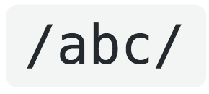
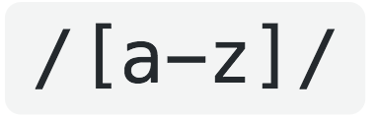
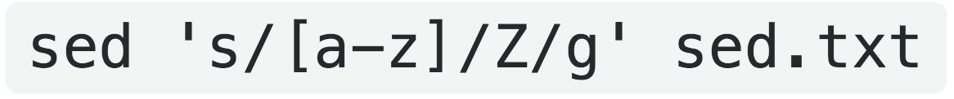
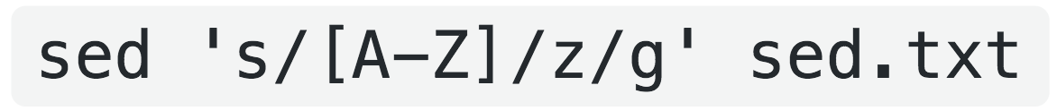
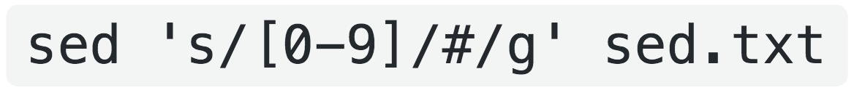
Regular expressions
Instructor Demo
Matches anytime these three letters are shown in this exact order.
Matches any string of lowercase letters.
What will each of these commands show?

Slide 15
-e
Instructor Demo
Chain together multiple sed commands to make multiple changes at once

Slide 16
Activity: Writing to a File (15 mins)
In this next activity, you will use sed to make some substitutions to a file.
Instructions:
Using the lights.txt file create a sed command that accomplishes the following:
Changes dark to bright where it makes sense to do so.
Changes bright to dark where it makes sense to do so.
Changes but to and in the first sentence.
Changes on to off at the end of the second sentence.

Slide 17
BREAK

Slide 18
awk…

Slide 19
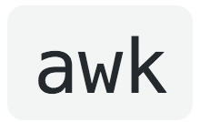
awk
awk is a programming language designed specifically for processing text.
Named after the last names of its creators:
Alfread Aho, Peter Weinberger, Brian Kernighan.
While you can use awk to create entire text processing programs, you can also use awk directly in the command line to complete quick and useful tasks.

Slide 20
gAWK-ing
Instructor Demo
awk envokes the awk program.
'{ }' wraps around the awk program that you will run.
print is awk's print command.

Slide 21
awk variables
Instructor Demo
(does same thing as previous command)
- $0 is awk’s variable that holds the entire value of each line
- Awk also assigns variables to each field in each line.
- By default, awk uses any white space it comes across to define a field.
printing out different fields =

Slide 22
Printing multiple variables
Instructor Demo
This command prints out different fields.
Comma’s between variables keep awk from concentrating everything together.
You can also create tabs between the output using \t between 2 variables in the print statement.

Slide 23
- F
Instructor Demo
-F flag allows you to change the delimiter that awk is using to separate the fields.

Slide 24
Regrex search
Instructor Demo
Regrex works the same with awk as it does in with sed.
“//” holds the search string or regrex.
Note: searches are case sensitive.

Slide 25
Activity: Start gAWK-ing (20 mins)
In this next activity, you will use sed to make some changes to a file.
Instructions:
Print only the first field of the 17-18-Breaches.txt.
Print only the breaches from 'web' companies
Out of the web companies that were breached, print only the company name
Print all the breaches from 2017
For the companies that had breaches in 2017, print only the company name and the number of records lost.
For the companies that had breaches in 2018, save the company name, Company type and number of breaches to a new file named 2018Breaches.txt

Slide 26
Start gAWK-ing Review
Instructor Review
Notes:
Review goals; address any questions.

Slide 27
Lesson Recap

Slide 28
Quick Review!
Which is the command we would use to execute shell scripts?
Notes:
Review goals; address any questions.

Slide 29
Quick Review!
Which is the command we would use to execute shell scripts?
sh
Notes:
Review goals; address any questions.

Slide 30
Quick Review!
Which is the command we would use to
write to new files?
Notes:
Review goals; address any questions.

Slide 31
Quick Review!
Which is the command we would use to
write to new files?
echo “Text” > {File}
Notes:
Review goals; address any questions.

Slide 32
Quick Review!
Which is the command we would use to
append to files?
Notes:
Review goals; address any questions.

Slide 33
Quick Review!
Which is the command we would use to
append to files?
echo “Text” >> {File}
Notes:
Review goals; address any questions.

Slide 34
Quick Review!
What does SSH stand for?
Notes:
Review goals; address any questions.

Slide 35
Quick Review!
What does SSH stand for?
Secure Shell
Notes:
Review goals; address any questions.

Slide 36
Today’s Goals
By the end of class, you will:
Create and execute shell scripts using Unix commands.
Employ research and documentation to identify new commands for unfamiliar situations.
Use sed to make substitutions to a file
Use awk to make changes to a file
Notes:
Review goals; address any questions.

Slide 37

Congratulations!
Mastering the Command Line is no trivial feat. And with this seemingly small skill—you’ve added a tremendous capability to your technical tool belt.

